Slide 1
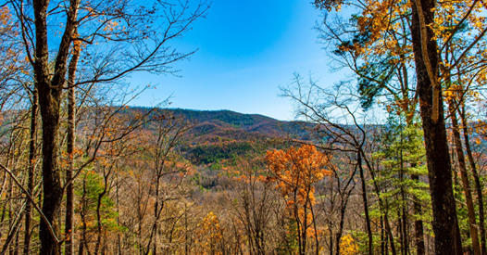
2019 Annual Utilities Report

Slide 2
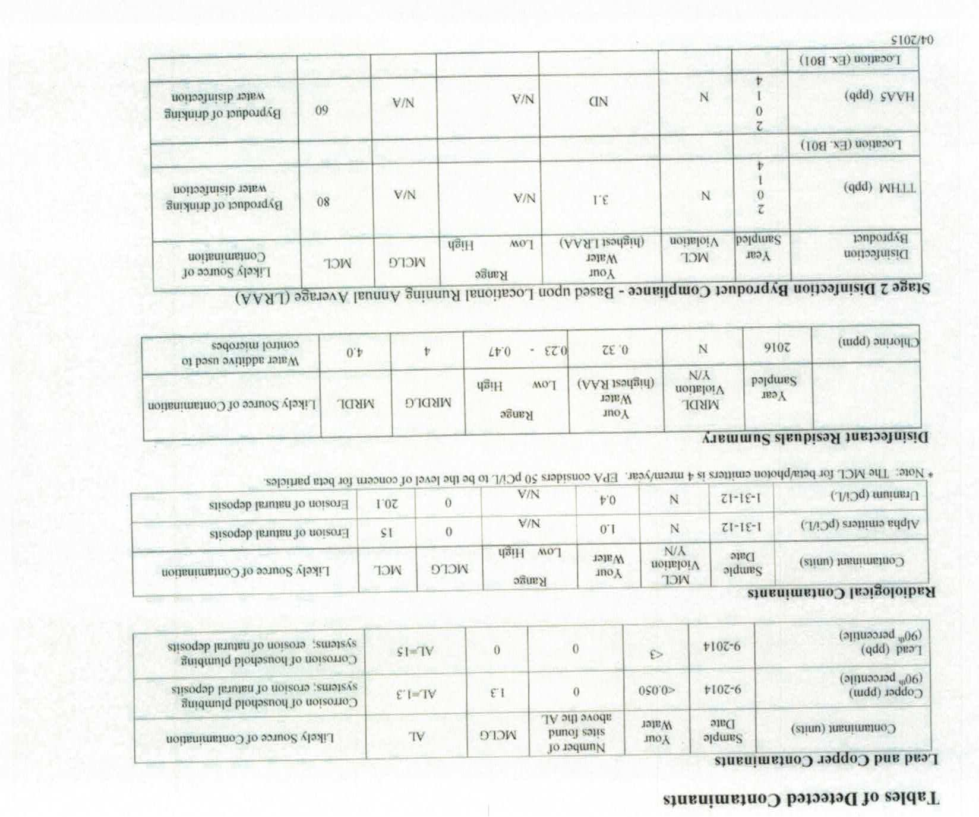
Water Quality
Our system is operated by James and James
It is routinely tested
An annual consumer confidence report is made available to all users in April based on the previous year’s data
Per Dr. H2O, our water is delicious!

Slide 3

Water Usage
Our tank is 100K gallons and our pump rate is 80 gpm
Individual homeowner water usage is not measured
We measure total water usage a means of determining if there are potential system leaks
Our current usage rate is approximately 7500 gallons per day
  Increase from 5000 gallons per day
  May be due to increased Inn utilization

Slide 4
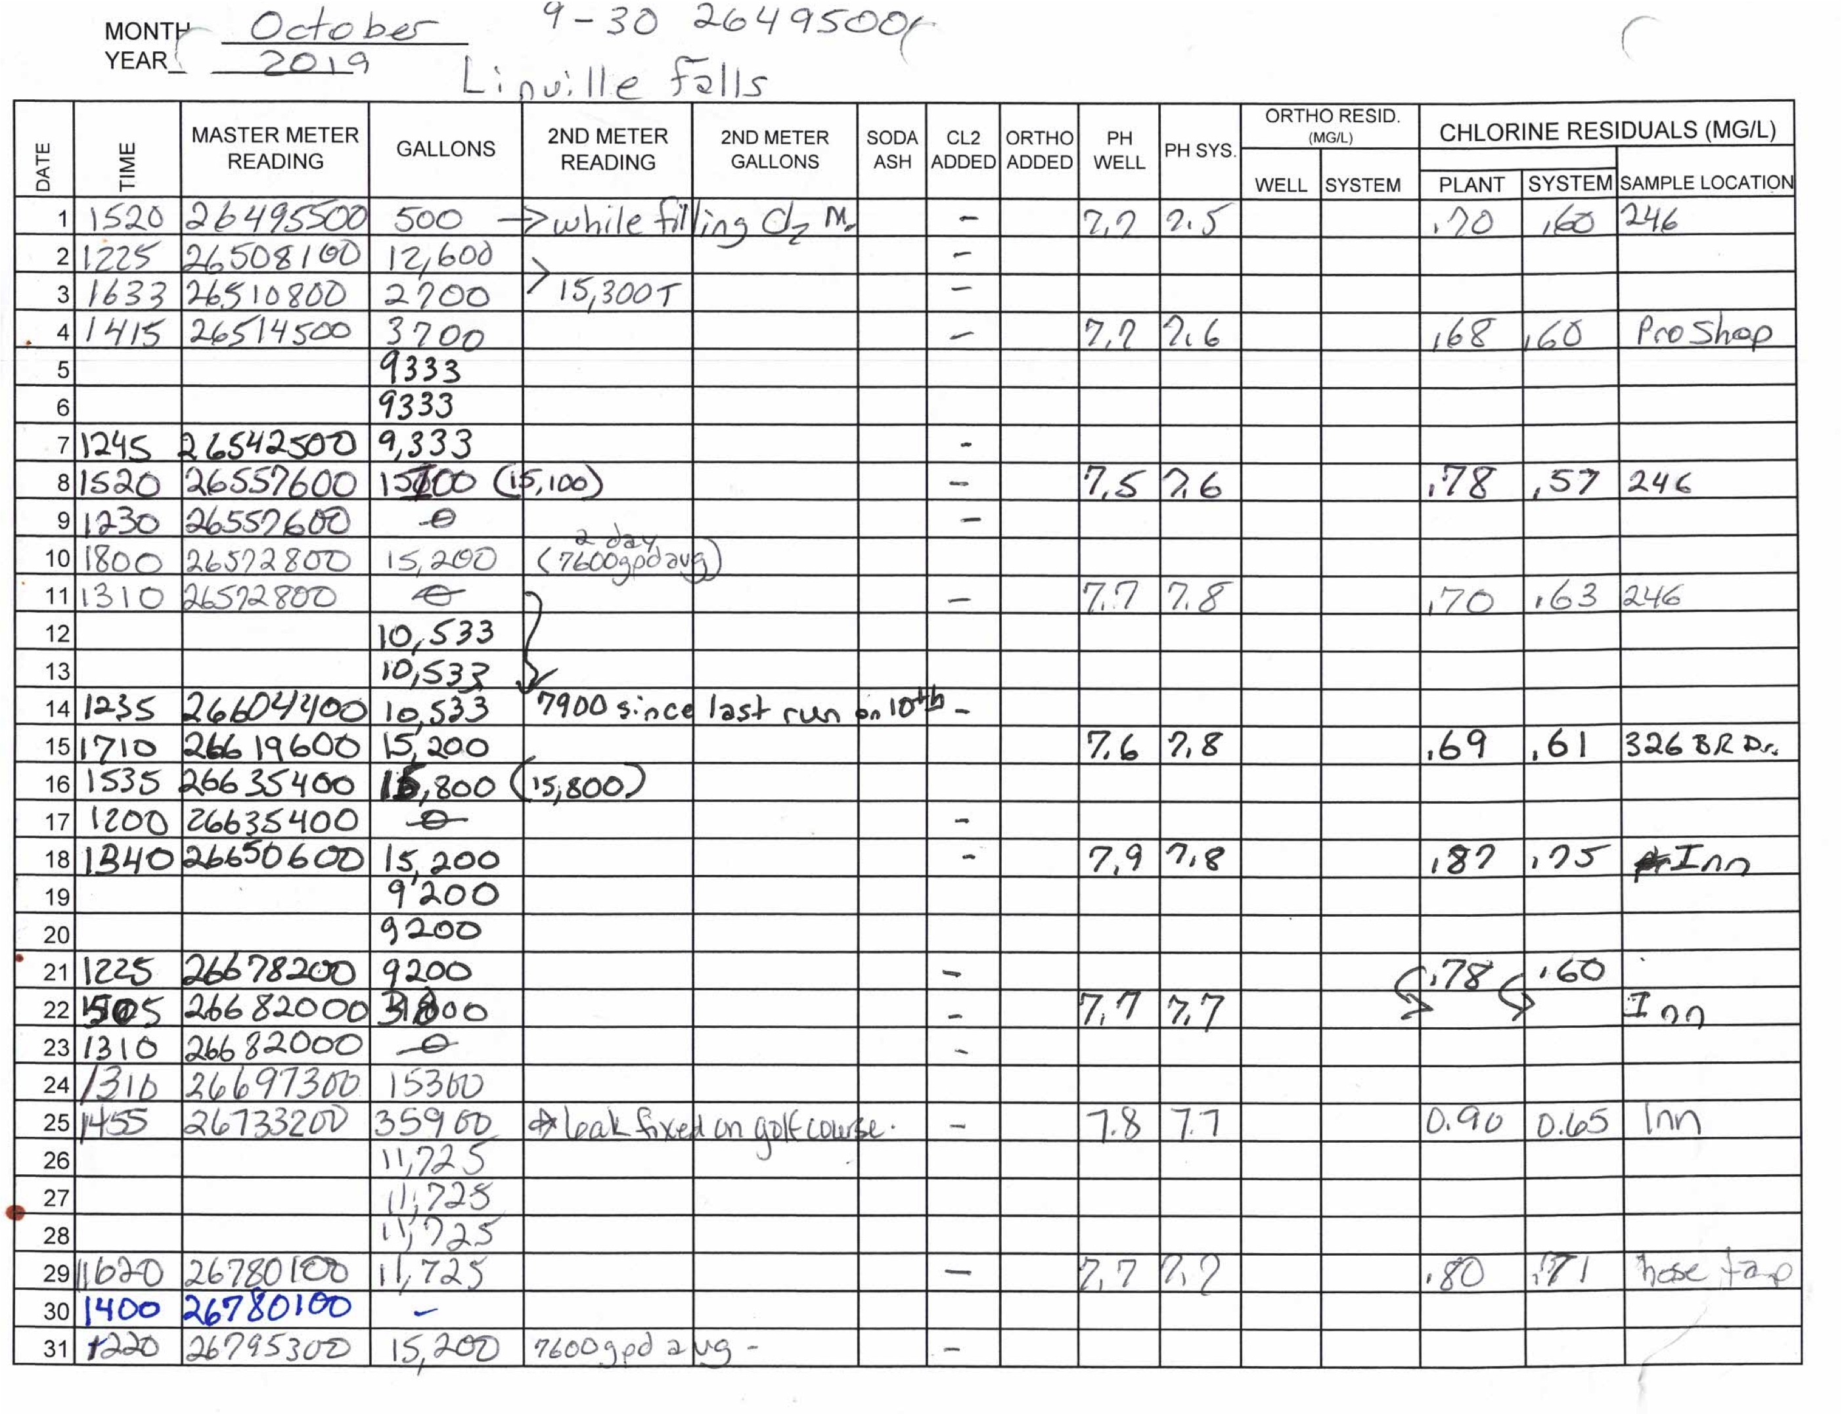
Water Conveyance System Leaks
We have identified and repaired several leaks this year:
Blue Ridge North (near lot 202)
  Large leak, required makeup of specialized fittings
Rocky Branch Trail (above lot 63)
Hunnicut Hollow
Hunnicut Mountain (at homeowner’s supply side)
Blue Ridge North (at homeowner’s supply side on lot 215)
* Leaks on the homeowner’s side of the valve box are the homeowner’s responsibility

Slide 5
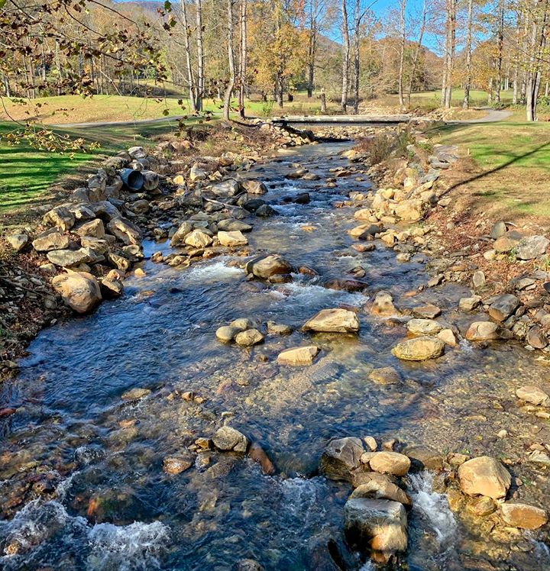
Wastewater Compliance
Our system is operated by James and James
Our discharge to the local Catawba River is monitored 5 days a week
We have had zero fines and non compliances in 2019
No major equipment failures
  Minor clog in clarifier & blockage in aeration basin in February
  REMC damaged effluent lines in August but paid for repairs

Slide 6
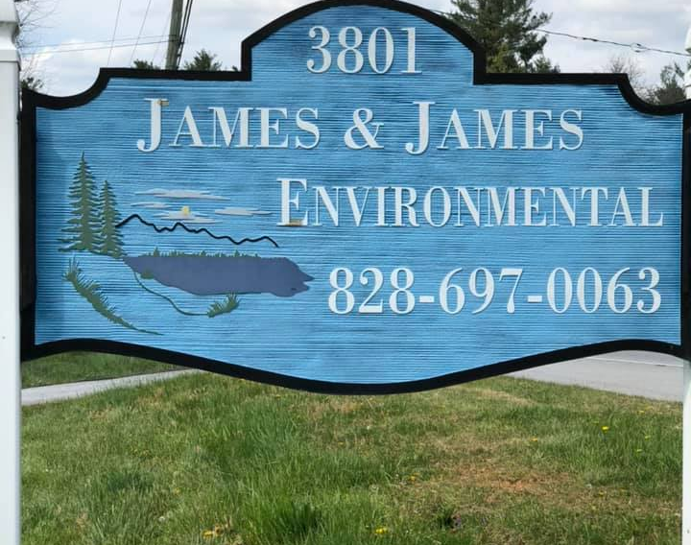
James and James Status
Potential merger between Envirolink Co and James & James was announced in the summer of 2019
We learned that the new company intended to greatly increase our service rate
James and James withdrew from the merger and continues to operate our system at the same cost

Slide 7
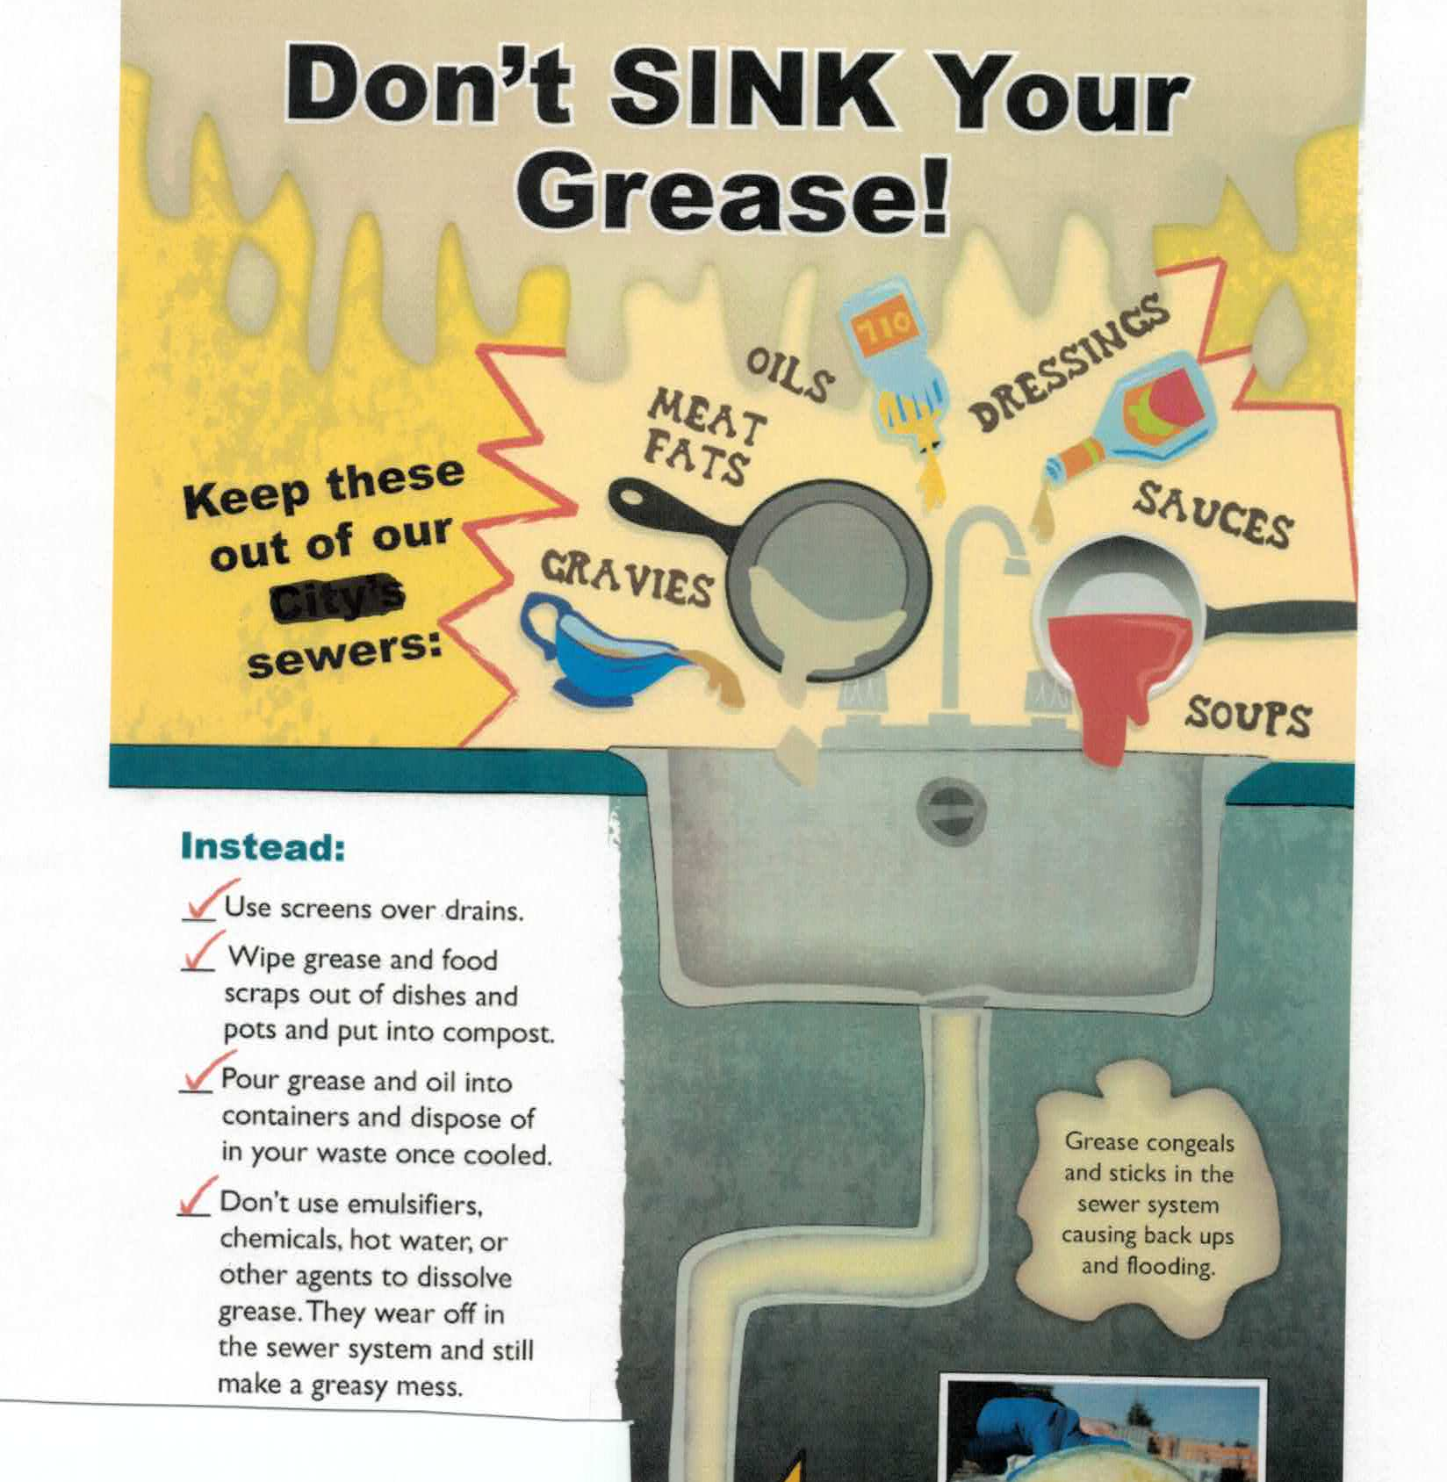
Sewer System – Homeowner Responsibilities
Keep Oil and Grease Out of the Sewers

Slide 8
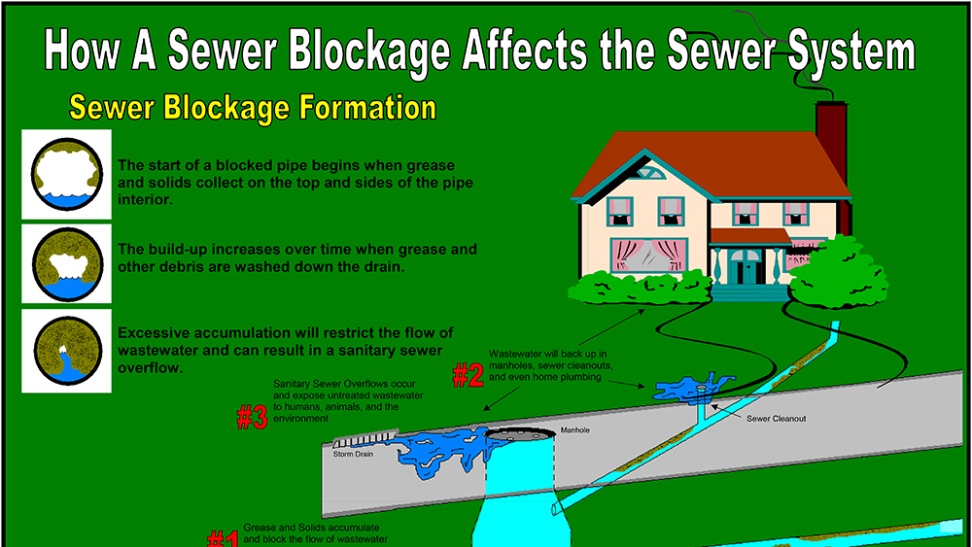

Slide 9
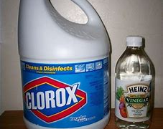
Sewer System – Homeowner Responsibilites
Do not discharge strong chemicals
Bleach, ammonia, or other strong chemicals can kill the biolife“bugs” in wastewater system

Slide 10
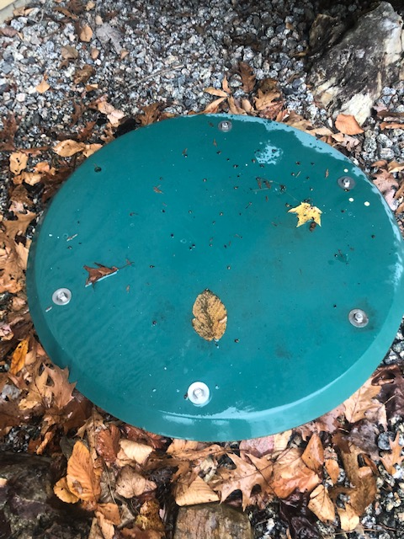
Sewer System- Homeowner Responsibilities
Each home is responsible for maintaining its own grinder pump
Our grinder pumps serve to push wastewater from our homes and through the community lines to the treatment plant
Failure of a grinder pump results in sewage overflowing to the ground and is a potential health issue
A&D offers a maintenance and inspection program for grinder pumps

