Slide 1
2019 Financial Report

Slide 2


LFCPOA Accounts
All monies received are deposited in our checking account in Marion.
Budget Reserve Account
Road Reserve Account
Utility Reserve Account
All transactions are recorded in QuickBooks.
Funds not currently needed are transferred to one of three EJ accounts.

Slide 3
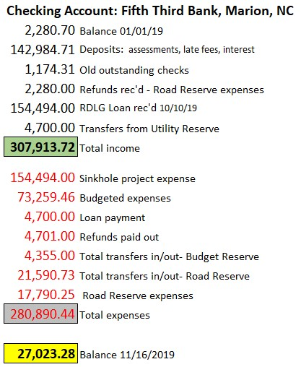
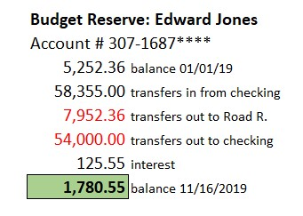

Slide 4
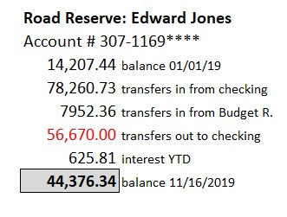


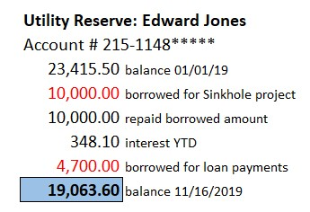

Slide 5
