Slide 1
2019 Financial Report

Slide 2


LFCPOA Accounts
All monies received are deposited in our checking account in Marion.
Budget Reserve Account
Road Reserve Account
Utility Reserve Account
All transactions are recorded in QuickBooks.
Funds not currently needed are transferred to one of three EJ accounts.

Slide 3
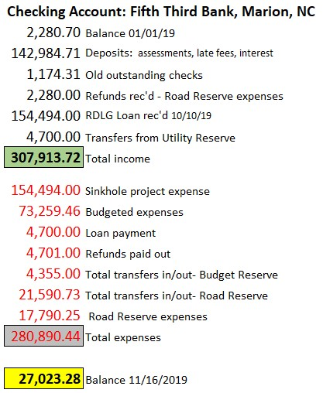
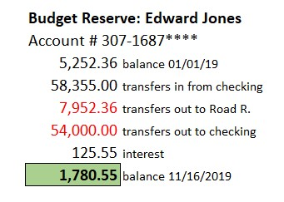
Budget Reserve: Edward Jones
5,252 balance 01/01/19
58,355 transfers in from checking
7,952 transfers out to road reserves
54,000 transfers out to checking
125 interest YTD
1,780 Balance 11/16/2019

Slide 4

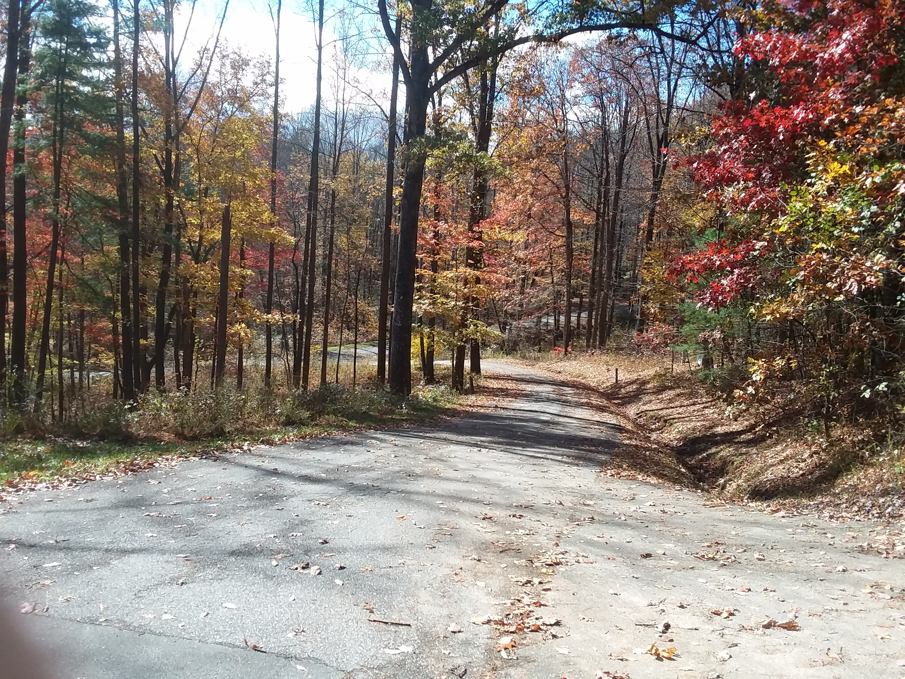
Road Reserve: Edward Jones
14,207 balance 01/01/19
78,260 transfers in from checking
7,952 transfers in from Budget Reserve
56,670 transfers out to checking
625 interest YTD
44,376 Balance 11/16/2019
Utility Reserve: Edward Jones
23,415 balance 01/01/19
10,000 borrowed for sinkhole project
10,000 repaid borrowed amount
348 interest YTD
4,700 borrowed for loan payments
19,063 balance 11/16/2019

Slide 5
